Slide 1
LPS (Logic-based Production Systems) The current implementation: practical aspects
RuleML LPS Tutorial
London, July 12, 2017
Robert Kowalski and Fariba Sadri
Imperial College London
Miguel Calejo
Interprolog.com

Slide 2
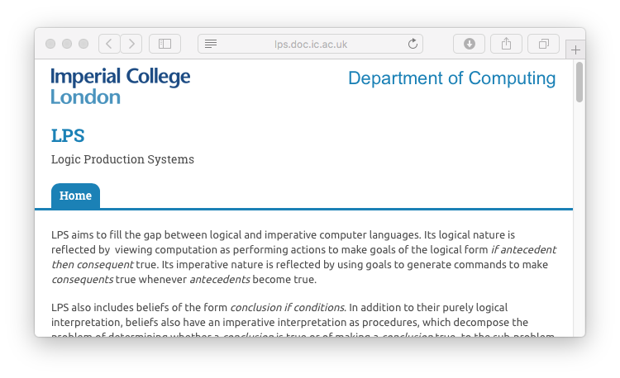
Logical Production Systems Resources
Main URL: http://lps.doc.ic.ac.uk
Online playground:
http://lpsdemo.interprolog.com
Only this week: http://lpsdemo2.interprolog.com
Source code:
https://bitbucket.org/lpsmasters/lps_corner
For local installation: SWI Prolog
Notes:
Show sites

Slide 3
Pragmatic perspective
happens(pickup(kant,fork1),3,4)
holds(available(fork1),3)
LPS is a SWI Prolog superset, adding:
Fluent and event rules and declarations
Post conditions, integrity constraints
Reactive rules, external observations:
LPS surface syntax is translated into Prolog code and facts, that are interpreted by the LPS runtime
Executing a program is:
Simulating it over a period of time, feeding it with observations (events)
No user input yet (well… manual textual input)
adjacent(fork5, kant, fork1)
Action!
pickup(kant,fork1) from 3 to 4
available(fork1) at 3

Slide 4
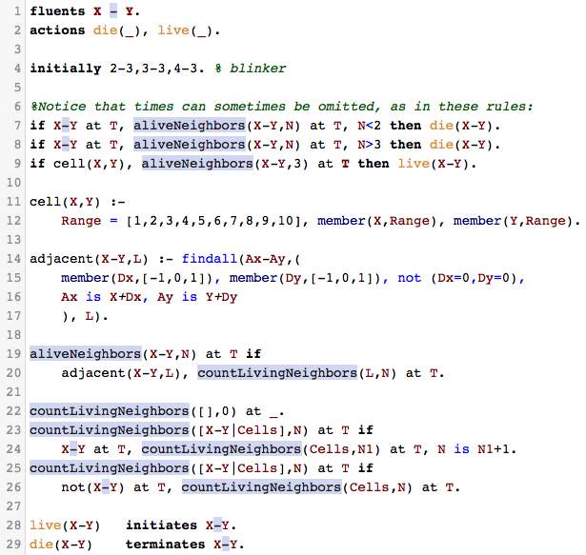
LPS surface syntax recap.
Literals (sorted symbols)
fluent at t1, event from t1 to t2, (timeless) p (Prolog-like)
Internally: holds(fluent,t1), happens(event,t1,t2), p
Composite events and intensional fluents
macro from T1 to Tn if e1 from T1 to T2, e2 from…
complexFluent at T if fluent1 at T, p, ...
Post-conditions: how actions affect fluents
e initiates/terminates f if condition
Pre-conditions: prevent “bad” actions
false someFluents, incompatibleActions.
Last but not least: reactive rules
If antecedent then consequent.
The rest: Prolog code
LPS syntax = Prolog + LPS constructs

Slide 5
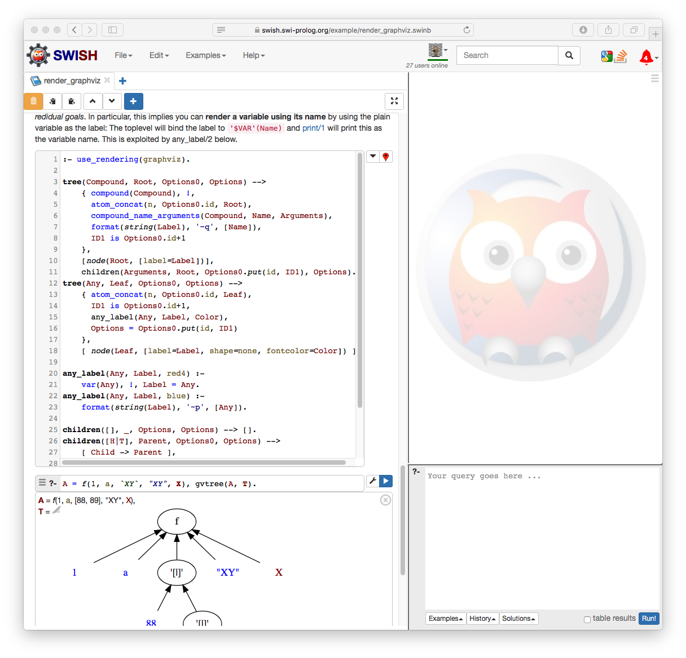
First, a word about SWISH 💕 …
A major innovation in logic programming!
Open source collaborative Prolog IDE on a web site
Notebooks for Prolog (as Jupyter does for Python)
Self-contained, efficient; SWI-Prolog is the server
Besides cute and friendly:
Just the visible tip of the powerful SWI Prolog IDE machinery
Extensible!
Solid HTTP app server built-in
Term rendering framework, DCGs + Javascript
Best of breed Javascript libraries
...a dream come true for developers of logic programming dialects…

Slide 6
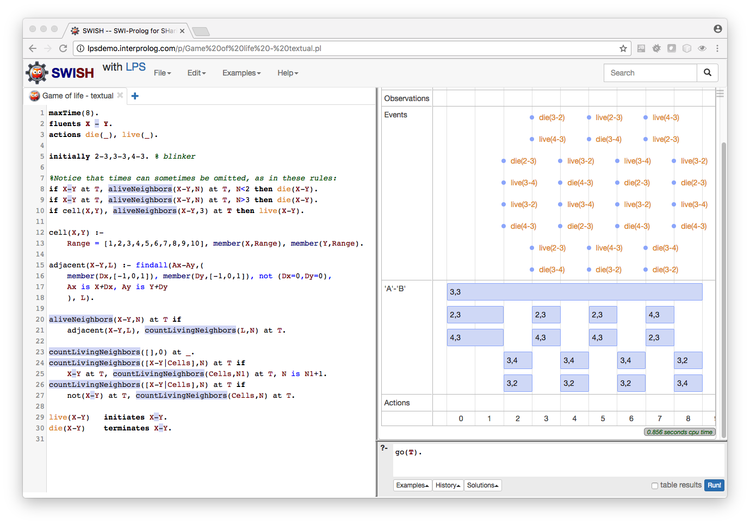
lpsdemo.interprolog.com(*) usage
Examples menu: First Steps with LPS, LPS Examples
Open or write program on the left pane
If you Save…, you can later reopen with “Open Recent...”
Either Download or copy to your plain text editor, to be safe
Errors reported in red – they must be fixed.
Type goal on query panel on the bottom right
go. % logs events and states over time
go(Timeline). % nicer: shows fluent/event timeline
dump. % see transformed program (Prolog)
Inspect the timeline... or see the log with fluent states and events
(*): you may also install your own local site instance in minutes
Notes:
Demo. Paste from editor. E.g. change live(_) action declaration to livee(_). Try goals shown.

Slide 7
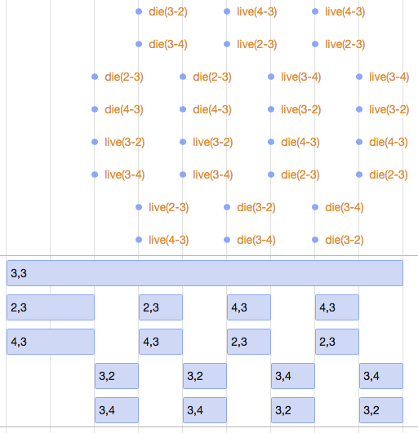
Making Life more interesting: 2D world
Timelines and textual logs are not the best for Game of Life…
Some fluents and events are best shown in 2D space..
…at each cycle: LPS cycle states drawn over (real) time
“annotation” d(LPS_term, Properties) :
Generates (sprites for frames of) a 2D animation
Declarative properties define display aspect of fluents, events… as well as ‘timeless’, non changing, background geometries
Game of Life facelifted
Let’s revisit bubble sort, dad saving energy...
2d documentation
Notes:
Explain then go to site. Show Javascript console. Show documentation

Slide 8

Game of life, live
Examples / LPS Examples menu
Uncomment d/2 declarations
1 second per LPS cycle
60, 30, 15 frames for longer simulations
Events can be shown too
Fade in/out around the cycle transition
Timeline still available (click top left corner of animation)

Slide 9
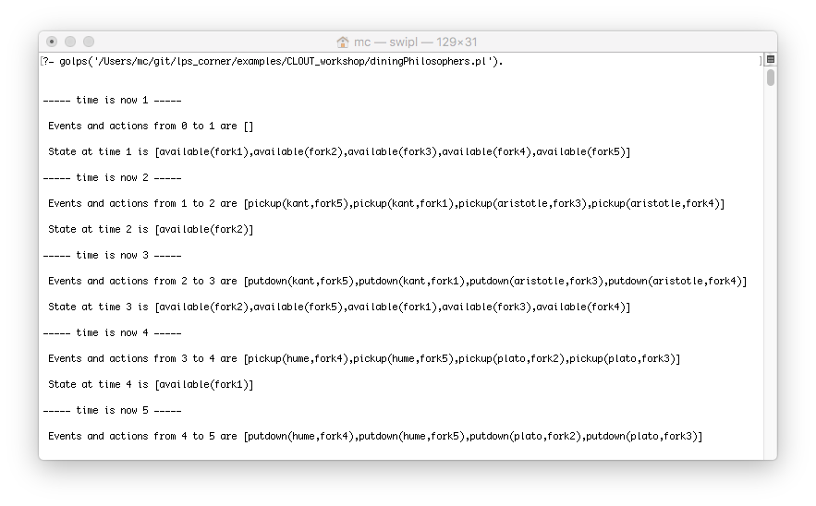
About the implementation
Engine history
Current main engine:
Sadri with student; later RK, MC
Started with XSB, moved to SWI in 2016
SWI specifics: delimited continuations variant; SWISH support
Other engines (Java):
cf. “bob the simplebot” sources from LPS main page
Installation alternatives
SWI
Barebones version
SWISH: local, cloud
XSB
Barebones
InterProlog Studio

Slide 10
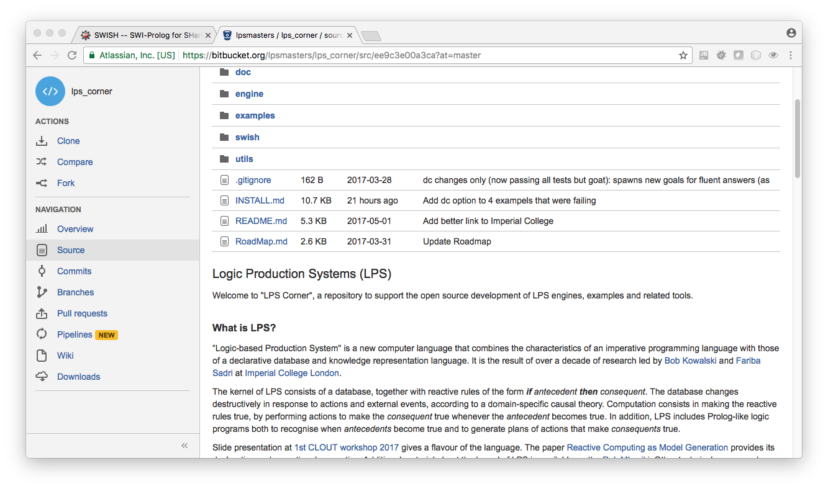
Source code tour from 30k feet- engine
https://bitbucket.org/lpsmasters/lps_corner/src
interpreter.P - Core engine, internal syntax
go(File,Options), cycle(ReactiveRules,Goals)
psyntax.P - Surface syntax processing:
Generates LPS internal syntax (Prolog) from LPS file
syntax2p/5, golps(File,Options).
Some options:
make_test: records trace of present execution in .lpst (“correct test result”) file
dc: delimited continuations variant
cycle_hook(Predicate,Fluents,Actions): e.g. callbacks to another language
timeout(Seconds)
Test suite:
interpreter:test_examples. (verifies results for all examples/ )
Notes:
Run on terminal: example, test suite

Slide 11
Source code tour from 30k feet– SWISH support
Running LPS programs in the cloud
LPS engine preloaded
Temporary ‘user’ module; term_expansion/2
Editor:
syntax coloring: extra info to feed SWI’s prolog_colouring.pl
error reporting: plug into SWI’s print_message/2 machinery
lps_corner/swish/user_module_file.pl
Renderers for LPS executions
Timelines
http://visjs.org
lps_corner/swish/lps_timeline_renderer.pl
2D world
http://paperjs.org
lps_corner/swish/lps_2d_renderer.pl
Notes:
If on time, show timeline renderer

Slide 12
Developing software with LPS
Preliminary LPS APIs, but lots of APIs to build upon
Platforms
Prolog app
import psyntax, use golps(..) predicate
Check state/1, happens/3
Java app
LPSEngine example (XSB): a simple synchronous LPS cycle handler
Shouldn’t be hard to implement for SWI
Bot the Simplebot : more extensive Java API, more limited (Java) LPS engine
Javascript app (TBD)
Embed in a pengines server (SWISH RPC infrastructure)
Python via PYSSWIP
LPS agents
LPS cycle loop may be used for interfacing real world events
Games, IoT, smart (logical) contracts…
Notes:
Run LPSEngine example on Eclipse

